Slide 1
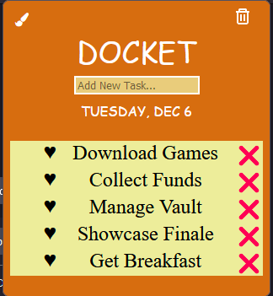
Docket
(Check list Extension)
By :
Siddharth Dahiya
Yash Dahiya
Caption

Slide 2
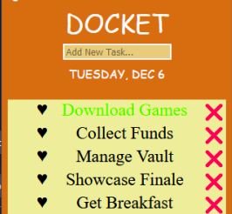
What is Docket?
Docket is practical for people who like to organize, plan, or do something later but forget about it later. It functions as a simple to-do list, preferred by most organizations for neat and orderly work. Since it also serves as a reminder for deadlines. Docket helps users manage their tasks while online browsing, researching, studying, shopping, and other activities.
A list of errands and other tasks often written as memory aid, that one needs or intend to accomplish.
Caption

Slide 3
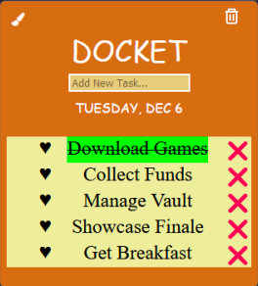
Reason for making Docket?
Docket will benefit most web users who like to plan, organise or do something later and not forget about it.
People use this concept frequently but mostly by writing it down. They will save time, space and energy by using Docket.
Caption

Slide 4
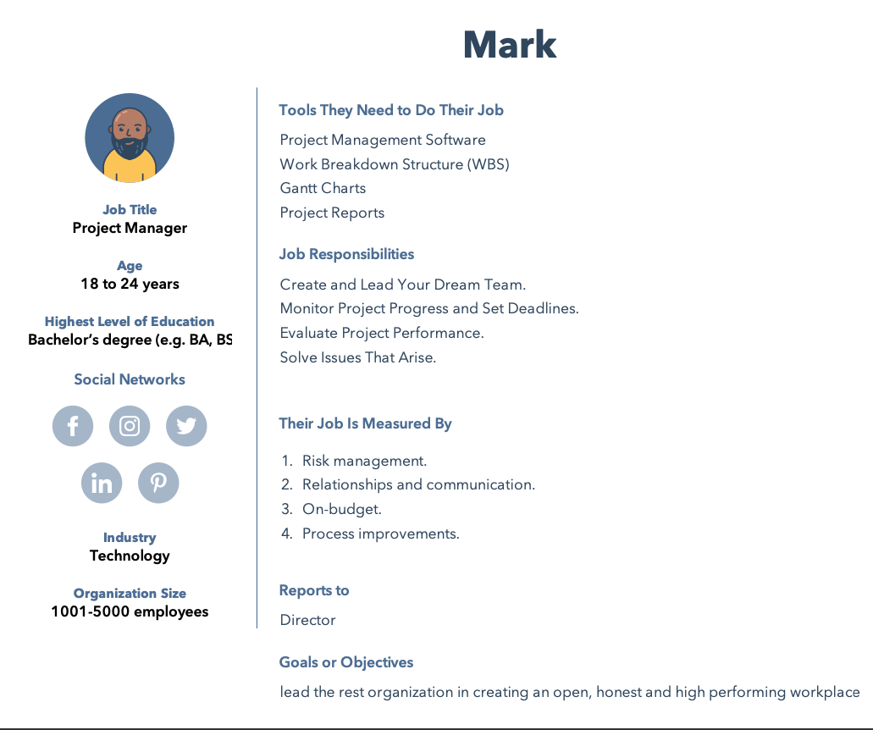
User Persona
Ideal user persona

Slide 5
How will Docket help mark?
Motivates the team
By finishing items on a to-do list, team members often feel accomplished and motivated to continue working on other tasks to complete the project successfully.
Improves Productivity
Having a to-do list can help team members see the various tasks they can complete to move a project forward, which can improve productivity among a team.
Delegating Tasks
Writing a to-do list can help project managers understand all the tasks of a project so they can delegate these assignments effectively.
Analysing work
By maintaining a to-do list, project managers can review and analyze the work their team has done on a project, which can help them identify best practices for future projects.

Slide 6
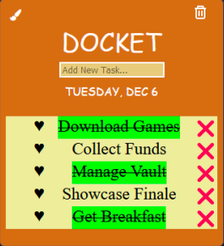
Building Phase
Design and requirements
This first step was to design the architecture and research the workable requirements of a to-do list from a similar API or extension.It tells us about the required permissions, structure of a to-do list extension, working API knowledge and management of browser site/tabs.
Code and Development
This phase was all about working on the prototype extension development. We applied the design knowledge to create an extension model that works with all functionality we mentioned.
Customisation and Appearance
We worked on the CSS and styles of extension to make it fancy and easier to use. We finally had the end product with a simple appearance that easy to use and compatible with most websites.
Caption

Slide 7
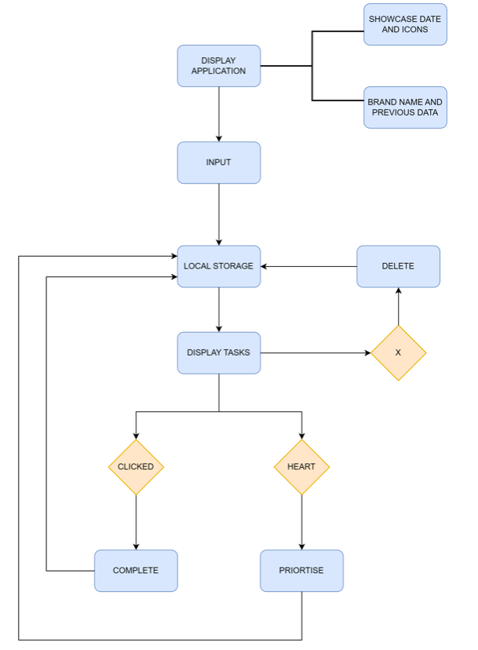
System Architecture
Caption

Slide 8
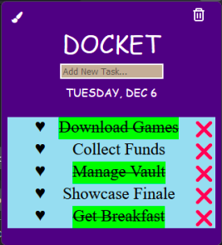
Versions of Docket
0.1.0-0.1.5
Built base model files for docket using default template. Designing HTML , CSS and Javascript file for docket.
0.2.0-0.2.5
Adding different functionalities adding, deleting tasks. Checking and highlighting completion of a task. Remove unwanted tasks. Working storage permission so items stay inside the model and do not disappear after clicking outside. Creating flags for tasks such as done remove.
0.3.0-0.3.4
Adding remaining functionalities such as remove all button, priority enabled tasks, editing colour scheme to match the background for CSS. Worked on cleaning bugs that resulted in mismatch errors.
Caption

Slide 9
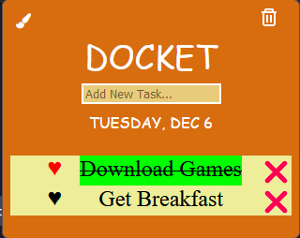
Functionalities of Docket
Input and Adding Tasks
Checking or Highlighting Completion of Tasks
Remove completed/unwanted Tasks
Remove all button
Priority Enabled Tasks
Editing color scheme to match background for CSS
Caption

Slide 10
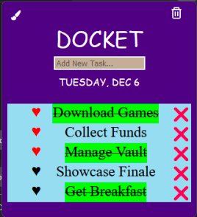
Strengths and Weakness
Strengths
Simple, easy to use, efficient design, user friendly.
Improves Productivity
Weakness
Readability Issues
Better UI Design
Caption

Slide 11
Decisions/Issues Dealt
Storage wasn’t always working or functioning properly.
Remove all (clear button) was always active irrespective of our preference.
Redesigning and Remodelling.
Cleaning bugs that were resulting in mismatch error.

Slide 12
Conclusion for Docket
It offers a way to increase productivity.
It helps one from forgetting things.
It helps prioritise tasks and manage them efficiently.
It helps with using time wisely and improve time management as well as the workflow

Slide 13
Questions?
For more information refer to the below:
https://github.com/yashdahiya0/CS4540-Mozilla-Project-Group-7

